Slide 1


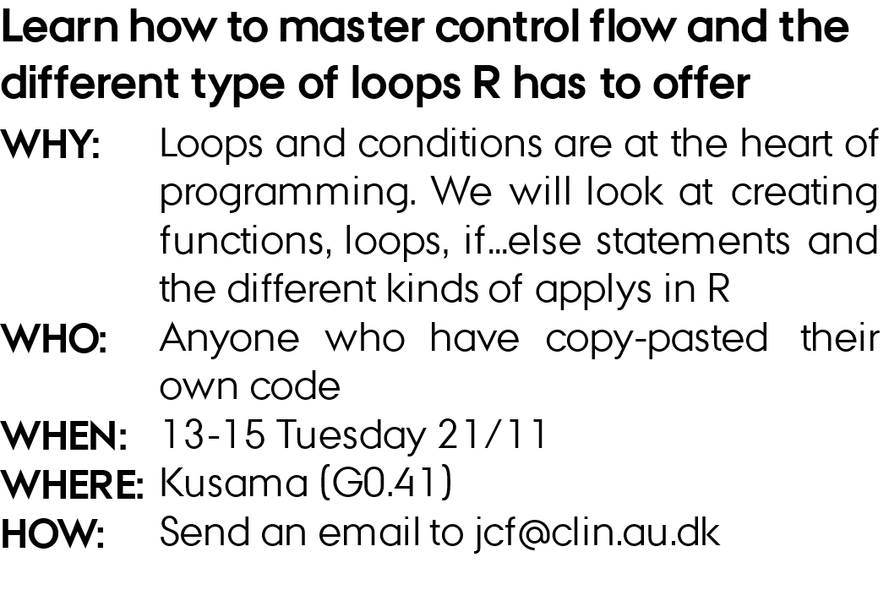
Control flow and loops

Slide 2
outline
Functions
Loops
Control flow
Debugging
Applys

Slide 3
Debugging
1) open ./MOMA R/Understanding R/01_files/01_debug.R

